Slide 1
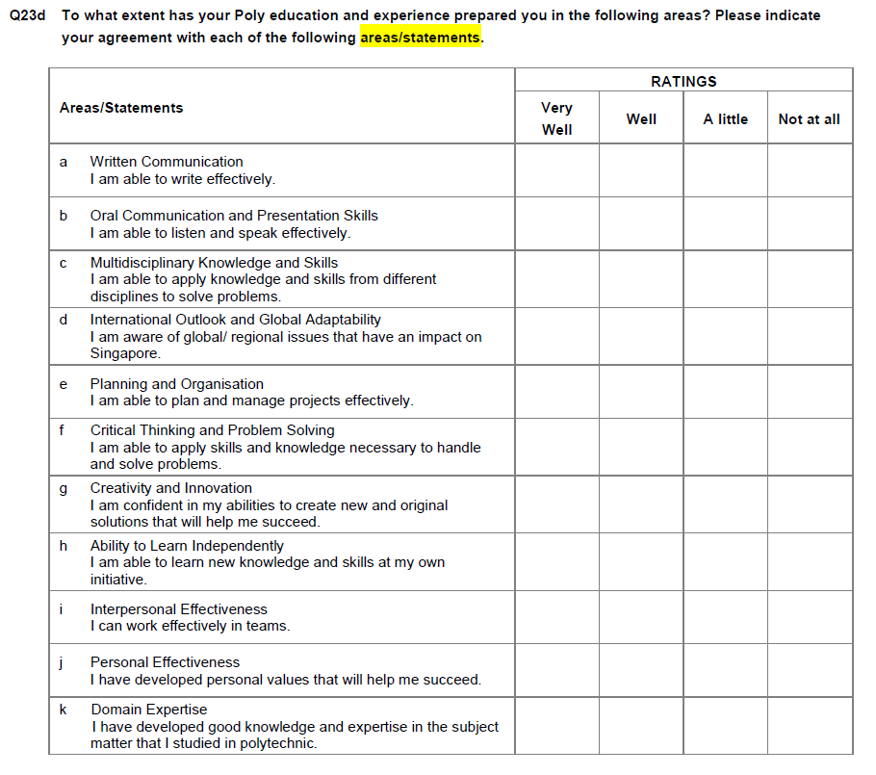
Graduate Employment Survey (GES) – Feedback on Lifeskills
Common set answered by all Poly graduates
NYP
vs
NP, RP, SP, TP
vs
All-Poly-Avg
PRF2019 and PRF2020 data for MOE.
Comparison of Poly results were shared at PRF2019.

Slide 2
Q23d_f Critical Thinking and Problem Solving
- I am able to apply skills and knowledge necessary to handle and solve problems.
Rated “Well/Very Well” out of a 4-point scale
Fresh Graduates (FG)
Post-NS Graduates (PNS)

Slide 3
Q23d_g Creativity and Innovation
- I am confident in my abilities to create new and original solutions that will help me succeed.
Rated “Well/Very Well” out of a 4-point scale
Fresh Graduates (FG)
Post-NS Graduates (PNS)

Slide 4
Q23d_c Multidisciplinary Knowledge and Skills
- I am able to apply knowledge and skills from different disciplines to solve problems.
Rated “Well/Very Well” out of a 4-point scale
Fresh Graduates (FG)
Post-NS Graduates (PNS)

Slide 5
Q23d_h Ability to Learn Independently
- I am able to learn new knowledge and skills at my own initiative
Rated “Well/Very Well” out of a 4-point scale
Fresh Graduates (FG)
Post-NS Graduates (PNS)

Slide 6
Q23d_b Oral Communication and Presentation Skills
- I am able to listen and speak effectively.
Rated “Well/Very Well” out of a 4-point scale
Fresh Graduates (FG)
Post-NS Graduates (PNS)

Slide 7
Q23d_i Interpersonal Effectiveness
- I can work effectively in teams.
Rated “Well/Very Well” out of a 4-point scale
Fresh Graduates (FG)
Post-NS Graduates (PNS)

